Slide 1

Help to get your voice into EPFL sustainability
Develop an EPFL application to foster sustainable projects on campus
Helping people to vote and act !
Open source code and AI embedded
Price – Balèlec tickets or gift baskets

Slide 2
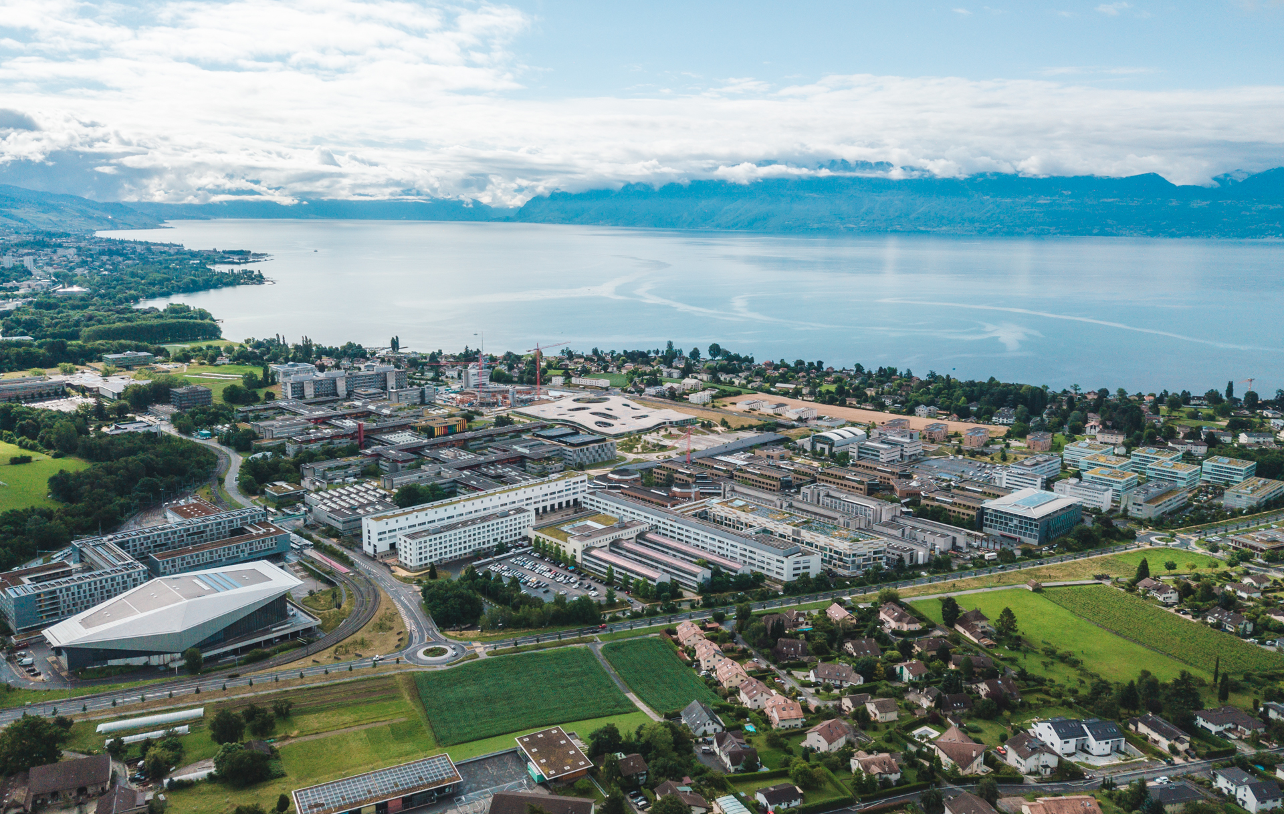
LauzHack 2023 – EPFL Challenge
Manuel Cubero-Castan - VPT
02-03 Décembre 2023

Slide 3








Ecole Polytechnique Fédérale de Lausanne: Who are we?
5 Schools
2 Colleges
21 instituts
4 EPFL’s associated campuses
6000 collaborators
Including 2000 PHD
343 professors
12000 students
VP for Academic Affairs
VP for Operations
VP for Finances
VP for Innovation
VP for Responsible Transformation
The EPFL Direction

Slide 4




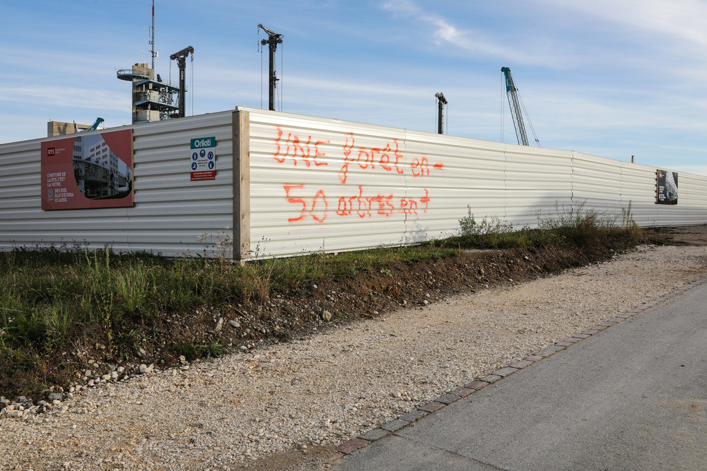

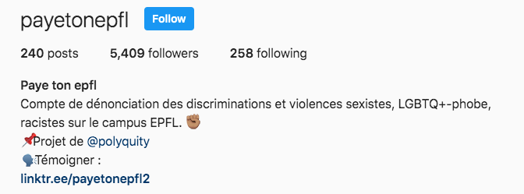



2019-20 : Strong pressure from students

Slide 5

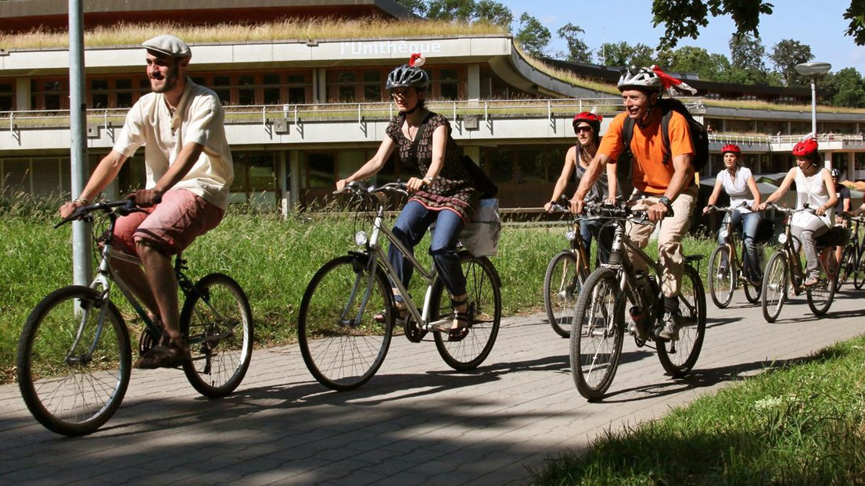
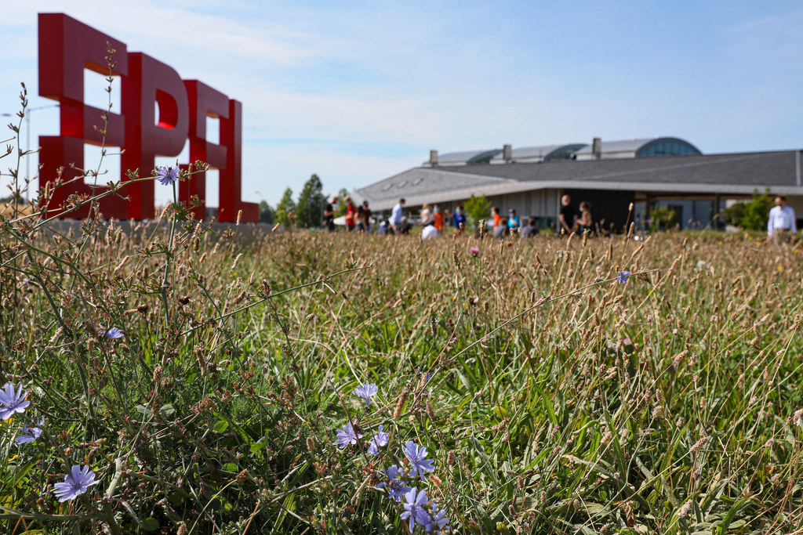
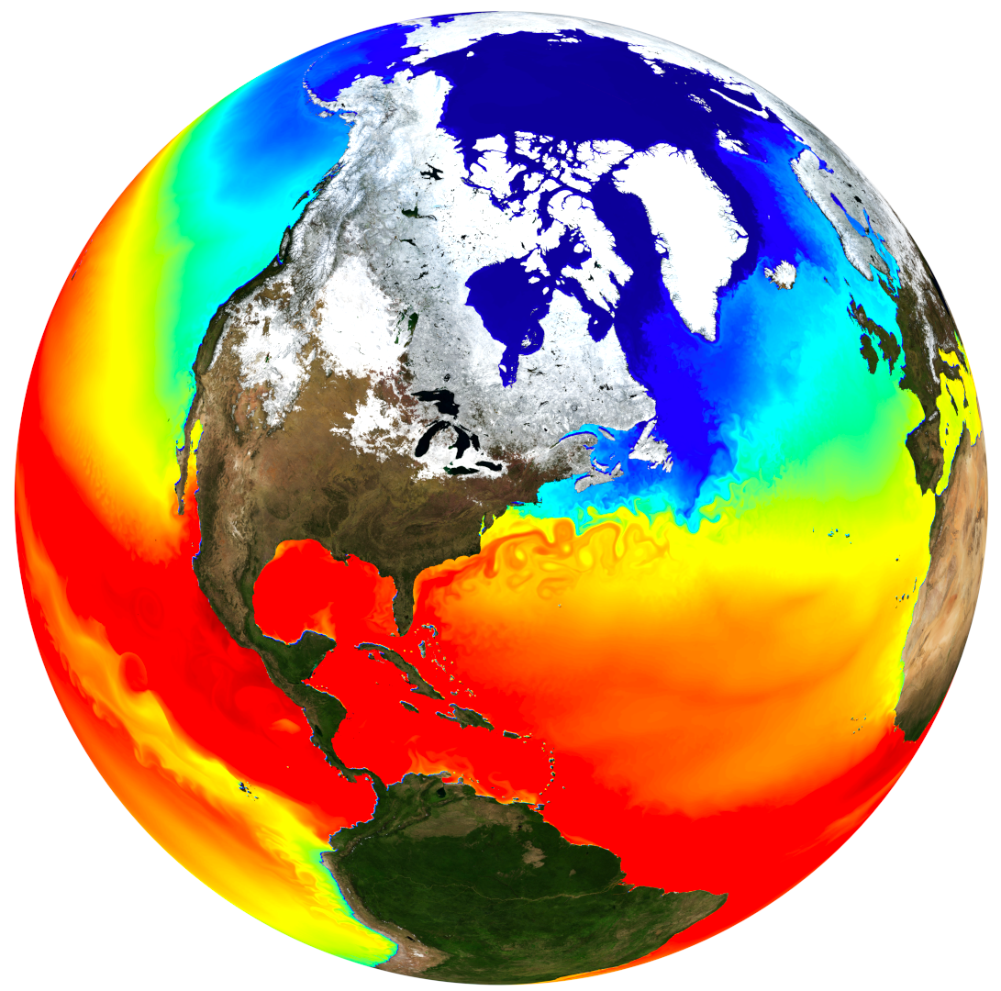


VPT: Vice-Presidency for Responsible Transformation
Help accelerate the transition to a sustainable, diverse, inclusive and responsible Campus

Slide 6
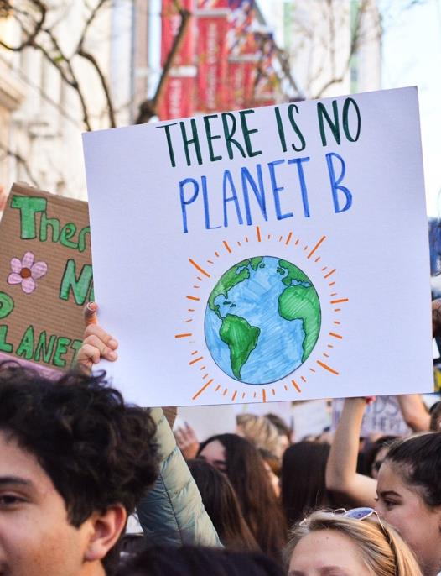
VPT Objectives
Working for a more inclusive, green, smart and sustainable campus
Spreading our values: respect, equality, diversity, inclusion and sustainability
Preparing the student body to meet environmental challenges
Reduce the school's carbon footprint
Supporting work-life balance

Slide 7
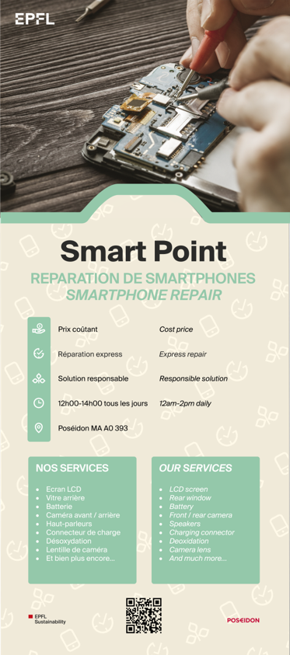
Point Smart
2023: Pilot phase for the projet
Around 300 smartphones repared
22 tons CO2eq if purchased
Increasing lifetime from 2 to 4 years on 17’000 people
➔ 320 tons CO2eq / an
Raising awareness on maintenance of our IT hardware
Increase lifetime to reduce environmental/social impact
Repair before Renew

Slide 8

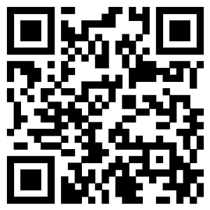
Old But Gold
Contest for all EPFL community
Answer few questions about your phone
Random draw among people
Better chances to win if your phone is old
From 15/11 to 8/12, take the chance to win !
Friday 15/12 at noon – Award ceremony
With games and other prices

Slide 9


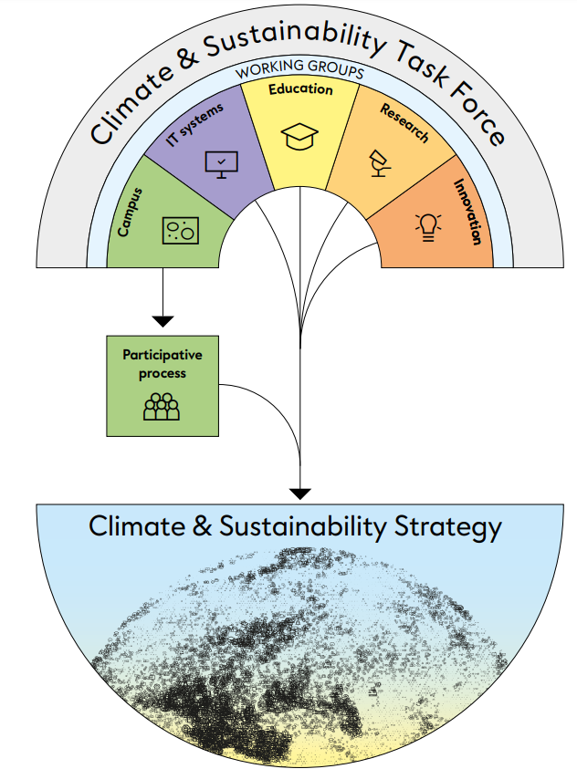
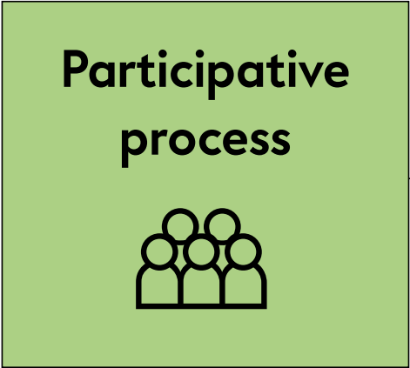
Climate and Sustainability Strategy: A living document !
A participative process from 2019 to 2022
First published strategy on Sustainability issues
Meant to evolve with time, becoming more precise and ambitious

Slide 10
Sustainability Challenge - Content
Aim: Fostering sustainable projects (ideas, concept) on EPFL campus, that came from and debated from EPFL community
2 phases application
Poll about questions asked from central services (VPT / Presidency)
Have a list for project that participants answered yes with time available to spend on.
Requesite:
Open source code, and easily changed for other usage
question from all community,
with or without anonymisation/moderation,
Add questions and forum debate
Meetup app during lunch to foster meeting according to availability / random
AI to resume concept on debated arguments

Slide 11
Some idea around the challenge
Voting system inspired from SmartVote
Make the choice for participants that vote for a project to mention how much time can they spend/give on such projects
Foster initiative and encourage action from the community
Timing crowdfunding = Random draw for participants that have voted yes for the projects and can spend time for it

Slide 12
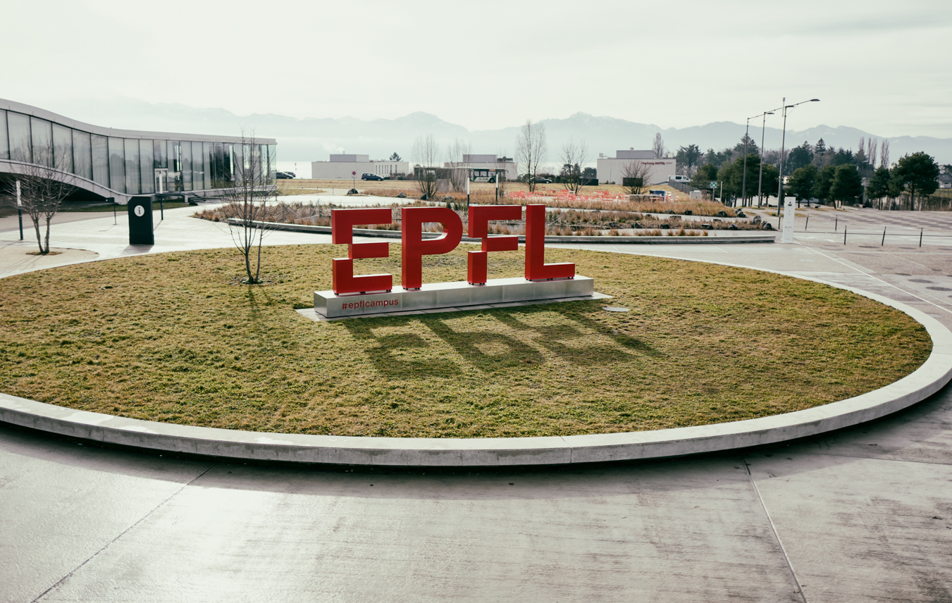
Merci
Manuel Cubero-Castan - VPT

